Slide 1
the Open Movement(s)
Dr Lyle Winton
Associate Director, Office for Research

Slide 2
Origins ?
One idea, it’s a human trait:
Psychology, personality structure five-factor model
Personality traits: openness, conscientiousness, extraversion, agreeableness, and neuroticism
openness vs closed (or sometimes intellect) – open to feelings, new ideas, reflection, flexibility of thought, cultural and creative interests, educational aptitude
Notes:
Digman, J.M. (1990). "Personality structure: Emergence of the five-factor model". Annual Review of Psychology 41: 417–440. doi:10.1146/annurev.ps.41.020190.002221

Slide 3
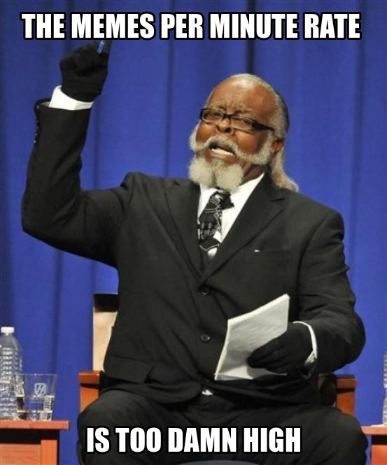
Many Facets
Open Design
Open-Source Software (1980’s)
Open-Source Hardware (1997)
Open Standards (1875???)
Open Science (1660’s)
Open Data (1882)
Open Access (1990??? online journal)
Open Information / Knowledge (1966? FOI)
Open Education (1966???)
Open Content / Free Culture (1999)
Open (transparent) Governance (1910’s)
Open Innovation / Business Models
memecrunch.com
Notes:
The relationships are not simple, and the list is not exhaustive. Open Design is an umbrella concept for software and hardware. Open Science incorporates, data, access, knowledge. Open Education incorporates Open-Source, Knowledge, and Content. (Content is more than access, it’s about reuse.)
Early 1980’s GNU, FSF, BSD.
1997, Bruce Perens launched the Open Hardware Certification Program. Open Design Foundation 1999.
1875 Convention du Mètre?
In 1660 England established the Royal Society and in 1666 the French established the French Academy of Sciences. Academic Journals began, 1665 started the Philosophical Transactions of the Royal Society.
First International Polar Year 1882-83. http://www.arctic.noaa.gov/aro/ipy-1/
1966, Education Resources Information Center (ERIC)
1999 Open Publication License (Open Content Project, David Wiley, now recommends CC)
... 2001 Creative Commons.
1919 Bavarian Soviet Republic, WWI British reaction against secrecy.
Aside: The photo is of Jimmy McMillian during an election debate. “The Rent is Too Damn High” is a political slogan adopted by Jimmy McMillan, a New York City resident and founder of the Rent Is Too Damn High Party who ran for New York’s state gubernatorial election in November 2010.

Slide 4
Open Innovation
“Companies can no longer keep their own innovation secrets to themselves; ... The key success is creating, in effect, an open platform around your innovations so your customers, your employees and even your competitors can build upon it...”
Randall Rothenberg, Strategy+Business & Booz Allen
Notes:
Read “researchers” “communities” “collaborators”

Slide 5
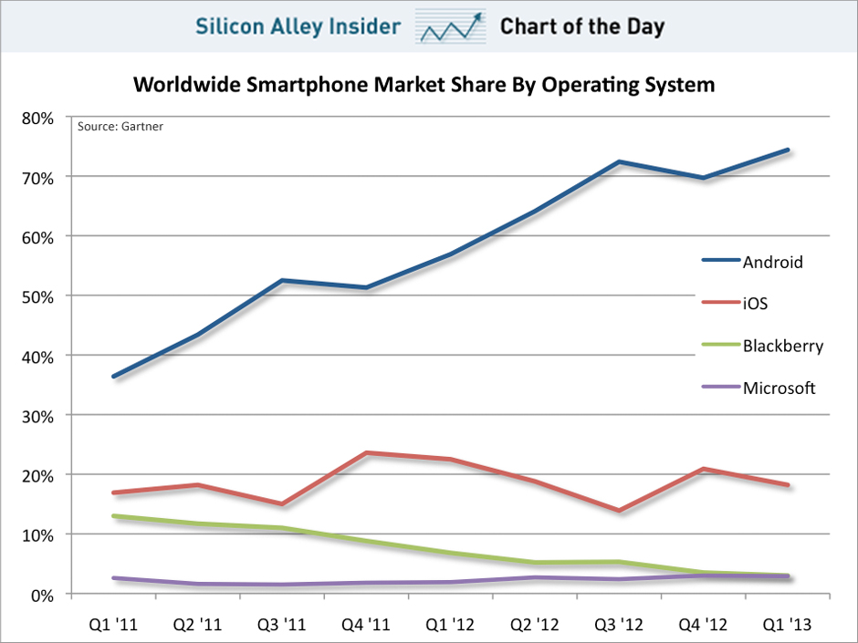
Commercial & Openness
Rivo netted $200M in 2012
$2.2B recent buyout offer
Notes:
2007 iPhone came out. Late 2008 first Android, came from behind.

Slide 6
Open Companies
Self proclaimed first “open company” (Chad Whitacre)
All governance, activities, information, finance, IP are public (but not customer privacy)
Charge as little as possible
Don’t compensate employees (crowd sourced salary)
Notes:
Open governance is not new.

Slide 7
Focusing on 4 concepts
Free Culture Movement
Open Education
Open Science (Research) & Data
the Commons
all cut across multiple “Open” facets

Slide 8
Free Culture / Open Content
Social movement – freedom to copy, share, use and modify creative works.
“Free culture artists make a point of working with their audiences instead of against them. They inhabit the Internet as natives, instead of stumbling around in awkward space-suits made of contracts and copyrights and permission forms whose real purpose is to cause enough friction that a corporation has to be paid off to reduce it.”
– posting from QuestionCopyright.org
Lawrence Lessig: “Laws that choke creativity” (TED Talk)
“read-write” vs “read-only” culture
Sparked: US Sonny Bono Copyright Term Extension Act (CTEA) 1998
Creative Commons NFP established 2001
Licenses in 2002. Protects reuse, distribution, building upon.
A science/research strand since 2004 (PLoS, BioMed Central, Nature)
Notes:
Do we live in a world were everyone is free to participate in creating and recreating culture, or only the few who own that right? Lessig argues the 20th century was characterised by (read-only) copyright, access and distribution cartels. (possibly Motion Picture Association of America, Recording Industry Association of America)

Slide 9
Open Education
“The world becomes more complex and interconnected at a lightning-fast pace, and almost every serious social issue requires an engaged public that is not only traditionally literate, but adept in a new, systemic literacy. ... It is also unlikely that sufficient resources will be available to build enough new campuses to meet the growing demand for higher education ... Nor is it likely that current methods of teaching and learning will suffice to prepare students for the lives they will lead in the twenty-first century.”
Notes:
Open Content – for greater access and allowing educators to repurpose for local and new relevance
Open Source Technologies – platforms for access and sharing
Open Knowledge – sharing with educators and experts

Slide 10
Is this a Human Right?
OAK Law Project Report 1 “Legal Framework for Open Access” 2006
(found in QUT’s institutional repository)

Slide 11
Is this a Human Right?
The Universal Declaration of Human Rights (UN, 1948)
Article 26 (1) Everyone has the right to education. ... Technical and professional education shall be made generally available and higher education shall be equally accessible to all on the basis of merit.
...
Article 27. (1) Everyone has the right freely to participate in the cultural life of the community, to enjoy the arts and to share in scientific advancement and its benefits. (2) Everyone has the right to the protection of the moral and material interests resulting from any scientific, literary or artistic production of which he is the author.

Slide 12
Is this a Human Right?
Charter of Fundamental Rights of the European Union (2000)
Article 11
“Everyone has the right to freedom of expression. This right shall include freedom to hold opinions and to receive and impart information and ideas without interference by public authority and regardless of frontiers.”
From European Convention on Human Rights (1950)
Article 13
“The arts and scientific research shall be free of constraint. Academic freedom shall be respected.”
Article 14
“Everyone has the right to education and to have access to vocational and continuing training.”

Slide 13
Is this a Human Right?
Healthcare Information for All by 2015 (HIFA2015)
10000 individuals & 184 organisations, 167 countries
The right to healthcare information.
UDHR 1948: “Everyone has the right to a standard of living adequate for the health and well-being of himself and of his family, including food, clothing, housing and medical care.”
“Tens of thousands of people die every day, often for the simple reason that the parent, carer or health worker lacks the information and knowledge they need to save them”
Access to original medical research as well as appropriate health reference and learning materials.

Slide 14
Is this a Human Right?
Declaration on Access to Research Data from Public Funding (OECD, 2004), ministers of the Committee for Scientific and Technological Policy
RECOGNISING that optimum availability of research data from public funding for developing countries will enhance their participation in the global science system, thereby contributing to their social and economic development; ...
Working towards establishing access regimes for digital research data ...
Openness: balancing the interests of open access to data...
Transparency: making information on data-producing organisations, documentation on the data... and... conditions
Notes:
Ministers of the Committee for Scientific and Technological Policy, Organisation for Economic Cooperation and Development.
http://acts.oecd.org/Instruments/ShowInstrumentView.aspx?InstrumentID=157&Lang=en&Book=False

Slide 15
Open Science
Making scientific research, findings and data more accessible
Open Access and publishing
Open Knowledge?
knowledge networks / completely open content
Open (science) data
available & usable
Open projects and crowd sourcing

Slide 16
“Man Thinking”
“In this (society’s) distribution of functions, the scholar is the delegated intellect. In the right state, he is, Man Thinking. In the degenerate state... a mere thinker...”
Ralph W Emerson, The American Scholar oration (1837).
Many global challenges, Requires global response
global warming, water resources, poverty, mental health, epidemiology, education
Approaches: conventions, summits, multilateral institutions, global initiatives

Slide 17
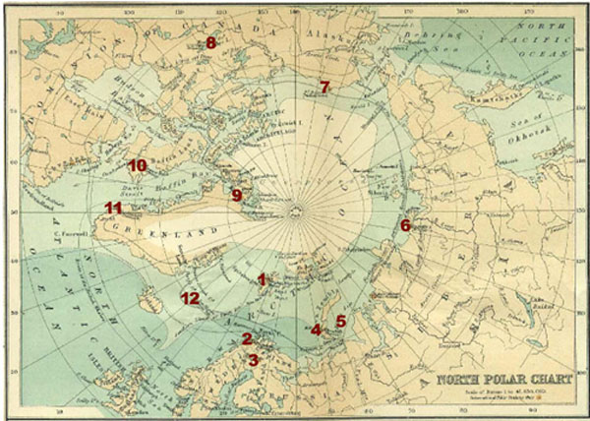
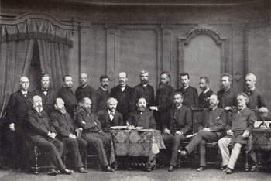
Open Data
Climate, the first?
First International Polar Year 1882-83.
Nations should put aside their unprofitable competition ... and instead field a series of coordinated expeditions dedicated to scientific research. (Carl Weyprecht)
11 nations, 700 men

Slide 18
Open Data
Second IPY 1932-1933, 40 nations
Third IPY 1957-1958, 67 nations
later renamed International Geophysical Year (IGY) because it included research outside Polar areas
International Council for Science, World Data Centres
1988 resolutions: “the success of international cooperative programs in science depends on an unprecedented sharing of scientific data and information; ICSU has a longstanding commitment to the free circulation of scientists and access to scientific data and information”
Fourth IPY 2007-2008, 63 nations, 50000 people
Notes:
Fourth I

Slide 19
Open Data
Human Genome Project 1990-2003, 113 people, 20 orgs
International Strategy Meeting on Human Genome Sequencing (1996)
Bermuda Principles
Automatic and immediate release of gene sequence data and sequences
Freely available in public domain for research, development, society
International Nucleotide Sequence Database Consortium (GenBank, EMBL, DDBJ)
A commons of sequence data
Others such as NCBI support
> 4 trillion sequences

Slide 20
the Commons
“A commons arises whenever a given community decides that it wishes to manage a resource in a collective manner, with a special regard for equitable access, use and sustainability. It is a social form that has long lived in the shadows of our market culture, but which is now on the rise.”
David Bollier
eg. Commons Land Rights, medieval England
Notes:
Common land (a common) is land owned collectively or by one person, but over which other people have certain traditional rights, such as to allow their livestock to graze upon it, to collect firewood, or to cut turf for fuel.

Slide 21
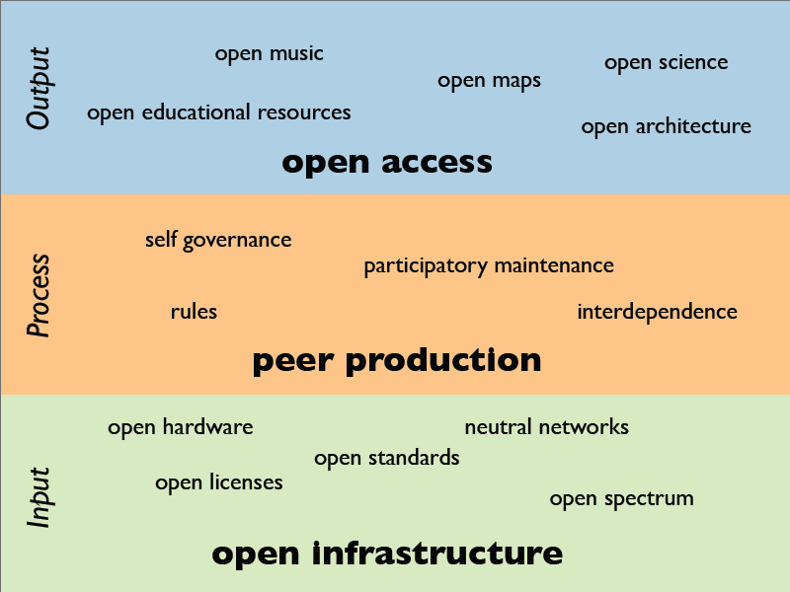
Commons Ecosystem (2008) Heather Ford, iCommons

Slide 22
the Commons
International Nucleotide Sequence Database Consortium
International Council for Science, World Data System
These are more than just databases, they are commons
Commons focus on participation and problems being addressed
Accessible Infrastructure
Governance, Rules and Process (can be self organising)
Open Outputs
(usually there’s a lot of “Open XYZ” involved)

Slide 23
Thank you!
Some good material:
Lawrence Lessig: “Laws that choke creativity” (TED talk, 2007)
“Opening Up Education: The Collective Advancement of Education through Open Technology, Open Content, and Open Knowledge”, T Iiyoshi (open access book, 2010)
“The Future of the *Global* Commons”, Heather Ford (iSummit presentation, 2008)

